Slide 1
CS F415: Data Mining
Yashvardhan Sharma

Slide 2
Today’s Outline
Data Preprocessing
  Discretization and Binarization
  Variable Transformation
  Measure of Similarity and dissimilarity

Slide 3
Discretization
Three types of attributes:
  Nominal — values from an unordered set
  Ordinal — values from an ordered set
  Continuous — real numbers
Discretization:
  divide the range of a continuous attribute into intervals
  Some classification algorithms only accept categorical attributes.
  Reduce data size by discretization
  Prepare for further analysis

Slide 4
Discretization and Concept hierachy
Discretization
  reduce the number of values for a given continuous attribute by dividing the range of the attribute into intervals. Interval labels can then be used to replace actual data values
Concept hierarchies
  reduce the data by collecting and replacing low level concepts (such as numeric values for the attribute age) by higher level concepts (such as young, middle-aged, or senior)

Slide 5
Concept Hierarchy Generation for Categorical Data
Specification of a partial ordering of attributes explicitly at the schema level by users or experts
  street<city<state<country
Specification of a portion of a hierarchy by explicit data grouping
  {Urbana, Champaign, Chicago}<Illinois
Specification of a set of attributes.
  System automatically generates partial ordering by analysis of the number of distinct values
  E.g., street < city <state < country
Specification of only a partial set of attributes
  E.g., only street < city, not others

Slide 6
Automatic Concept Hierarchy Generation
Some concept hierarchies can be automatically generated based on the analysis of the number of distinct values per attribute in the given data set
  The attribute with the most distinct values is placed at the lowest level of the hierarchy
  Note: Exception—weekday, month, quarter, year
country
15 distinct values
province_or_ state
65 distinct values
city
3567 distinct values
street
674,339 distinct values

Slide 7
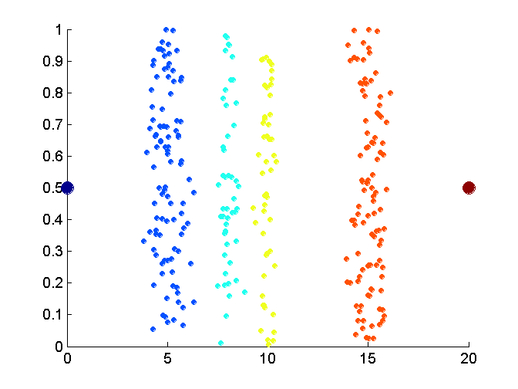
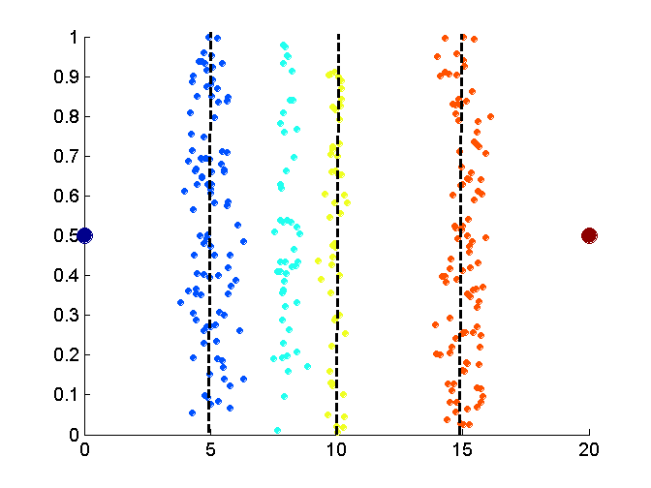
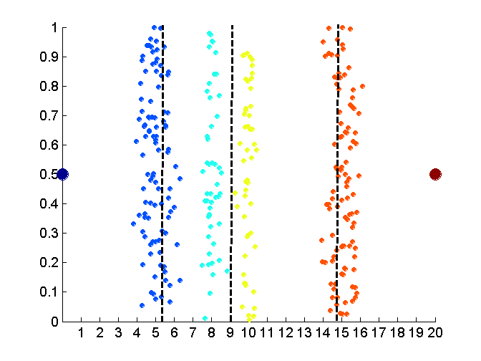
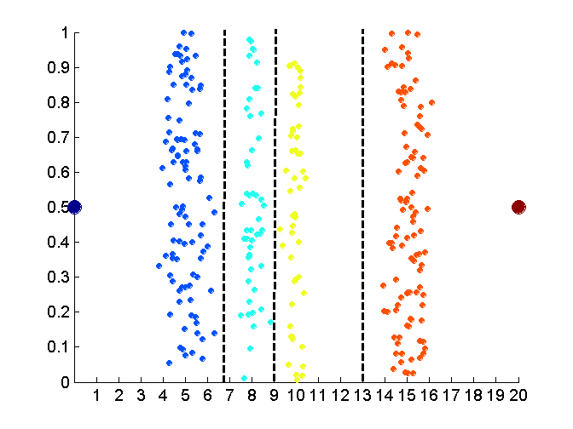
Discretization Without Using Class Labels
Data
Equal interval width
Equal frequency
K-means

Slide 8
Entropy-based discretization
Information-based measure – entropy
Recursively partition the values of a numeric attribute (hierarchical discretization)
Method: Given a set of tuples, S, basic method for entropy-based discretization of A (attribute) is as follows:

Slide 9
Cont’d
Each value of A can be considered a potential interval boundary or threshold T. For example, a value v of A can partition the samples in S into two subsets satisfying the condition A < v and A >= v – binary discretization
Given S, the threshold value selected if the one that maximizes the information gain resulting from subsequent partitioning.

Slide 10
Information gain
S₁ and S₂ – the samples in S satisfying the condition A < T and A >=T

Slide 11
Entropy function
Ent for a given set is calculated based on the class distribution of the samples in the set. Eg, given m classes, the entropy of S₁ is
P_{i} – probability of class i in S₁, determined by dividing the number of samples of class i in S₁ by the total number of samples in S₁

Slide 12
Entropy-based (1)
Given attribute-value/class pairs:
  (0,P), (4,P), (12,P), (16,N), (16,N), (18,P), (24,N), (26,N), (28,N)
Entropy-based binning via binarization:
  Intuitively, find best split so that the bins are as pure as possible
  Formally characterized by maximal information gain.
Let S denote the above 9 pairs, p=4/9 be fraction of P pairs, and n=5/9 be fraction of N pairs.
Entropy(S) = - p log p - n log n.
  Smaller entropy – set is relatively pure; smallest is 0.
  Large entropy – set is mixed. Largest is 1.

Slide 13
Entropy-based (2)
Let v be a possible split. Then S is divided into two sets:
  S1: value <= v and S2: value > v
Information of the split:
  I(S1,S2) = (|S1|/|S|) Entropy(S1)+ (|S2|/|S|) Entropy(S2)
Goal: split with maximal information gain.
Possible splits: mid points b/w any two consecutive values.

Slide 14
Cont.
For v=14
I(S1,S2) = 0 + 6/9*Entropy(S2)
= 6/9 * 0.65
= 0.433
The best split is found after examining all possible splits.
Try for v 16, find I(S1,S2) ?
The process of determining a threshold value is recursively applied until the following stopping criteria
The above example no more splitting because S1&S@ contains purely class, i.e., all P and all N

Slide 15
Example: fair coin throw
P (head) = 0.5
P (tail) = 0.5
Example: Coin Flip
  A_{X} = {heads, tails}
  P(heads) = P(tails) = ½
  ½ log₂(½) = ½ * - 1
  H(X) = 1

Slide 16
Example: biased coin throw
What about a two-headed coin?
Conditional Entropy:
P(head) | 0.5 | 0.25 | 0.1 | 0
P(tail) | 0.5 | 0.75 | 0.9 | 1
Entropy | 1 | 0.811 | 0.469 | 0.000

Slide 17
Entropy of a split
Information in a split with x items of one class, y items of the second class

Slide 18
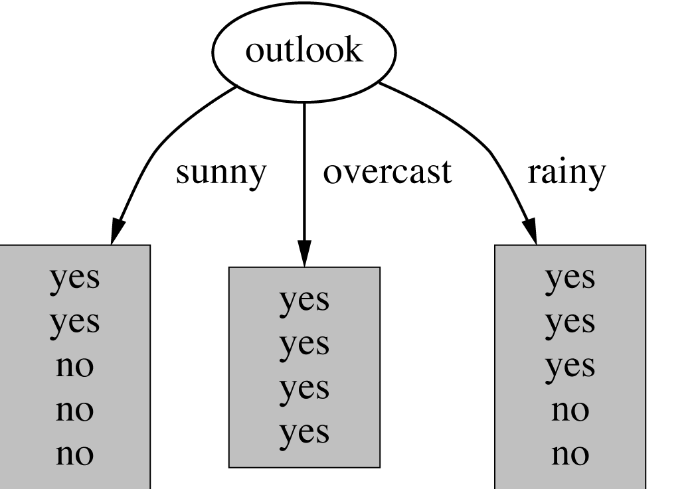
Example: attribute “Outlook”
“Outlook” = “Sunny”: 2 and 3 split

Slide 19
Outlook = Overcast
“Outlook” = “Overcast”: 4/0 split
Note: log(0) is not defined, but we evaluate 0*log(0) as zero

Slide 20
Outlook = Rainy
“Outlook” = “Rainy”:

Slide 21
Expected Information
Expected information for attribute:

Slide 22
Computing the information gain
Information gain:
(information before split) – (information after split)
Information gain for attributes from weather data:

Slide 23
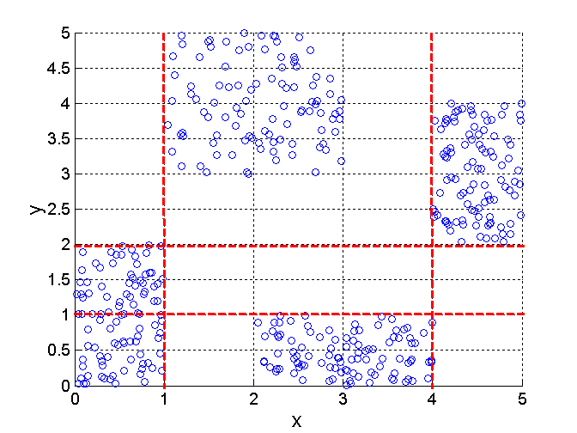
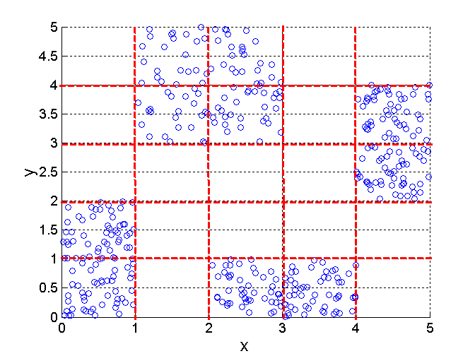
Discretization Using Class Labels
Entropy based approach
3 categories for both x and y
5 categories for both x and y

Slide 24
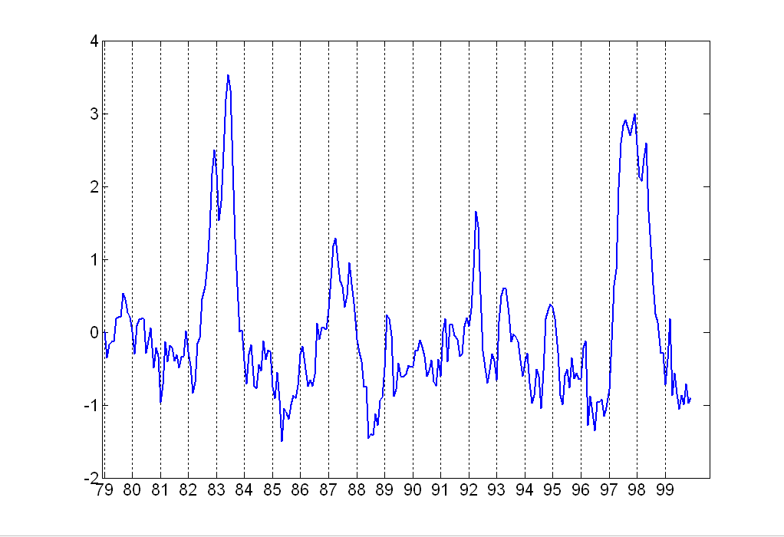
Attribute Transformation
A function that maps the entire set of values of a given attribute to a new set of replacement values such that each old value can be identified with one of the new values
  Simple functions: x^{k}, log(x), e^{x}, |x|
  Standardization and Normalization

Slide 25
Numerosity Reduction
Reduce the data volume by choosing alternative ‘smaller’ forms of data representation
Two type:
  Parametric – a model is used to estimate the data, only the data parameters is stored instead of actual data
    regression
    log-linear model
  Nonparametric –storing reduced representation of the data
    Histograms
    Clustering
    Sampling

Slide 26
Regression and Log-Linear Models
Linear regression: Data are modeled to fit a straight line
  Often uses the least-square method to fit the line
Multiple regression: allows a response variable Y to be modeled as a linear function of multidimensional feature vector
Log-linear model: approximates discrete multidimensional probability distributions

Slide 27
Regression
Develop a model to predict the salary of college graduates with 10 years working experience
Potential sales of a new product given its price
Regression - used to approximate the given data
The data are modeled as a straight line.
A random variable Y (response variable), can be modeled as a linear function of another random variable, X (predictor variable), with the equation

Slide 28
Cont’d
The variance of Y is assumed to be constant
α and β (regression coefficients) – Y-intercept and the slope line.
  Can be solved by the method of least squares. (minimizes the error between actual line separating data and the estimate of the line)

Slide 29
Cont’d

Slide 30
Regress Analysis and Log-Linear Models
Linear regression: Y = α + β X
  Two parameters , α and β specify the line and are to be estimated by using the data at hand.
  using the least squares criterion to the known values of Y1, Y2, …, X1, X2, ….
Multiple regression: Y = b0 + b1 X1 + b2 X2.
  Many nonlinear functions can be transformed into the above.
Log-linear models:
  The multi-way table of joint probabilities is approximated by a product of lower-order tables.
  Probability: p(a, b, c, d) = αab βacχad δbcd

Slide 31
Histograms
A popular data reduction technique
Divide data into buckets and store average (sum) for each bucket
Can be constructed optimally in one dimension using dynamic programming
Related to quantization problems.

Slide 32
Clustering
Partition data set into clusters, and one can store cluster representation only
Can be very effective if data is clustered but not if data is “smeared”
Can have hierarchical clustering and be stored in multi-dimensional index tree structures
There are many choices of clustering definitions and clustering algorithms, further detailed in Chapter 8

Slide 33
Data Compression
String compression
  There are extensive theories and well-tuned algorithms
  Typically lossless
  But only limited manipulation is possible without expansion
Audio/video compression
  Typically lossy compression, with progressive refinement
  Sometimes small fragments of signal can be reconstructed without reconstructing the whole

Slide 34
Data Compression
Original Data
Compressed
Data
lossless
Original Data
Approximated
lossy

Slide 35
Wavelet Transformation
Haar2
Daubechie4
Discrete wavelet transform (DWT): linear signal processing, multi-resolutional analysis
Compressed approximation: store only a small fraction of the strongest of the wavelet coefficients
Similar to discrete Fourier transform (DFT), but better lossy compression, localized in space
Method:
  Length, L, must be an integer power of 2 (padding with 0s, when necessary)
  Each transform has 2 functions: smoothing, difference
  Applies to pairs of data, resulting in two set of data of length L/2
  Applies two functions recursively, until reaches the desired length

Slide 36
Similarity and Dissimilarity
Similarity
  Numerical measure of how alike two data objects are.
  Is higher when objects are more alike.
  Often falls in the range [0,1]
Dissimilarity
  Numerical measure of how different are two data objects
  Lower when objects are more alike
  Minimum dissimilarity is often 0
  Upper limit varies
Proximity refers to a similarity or dissimilarity

Slide 37
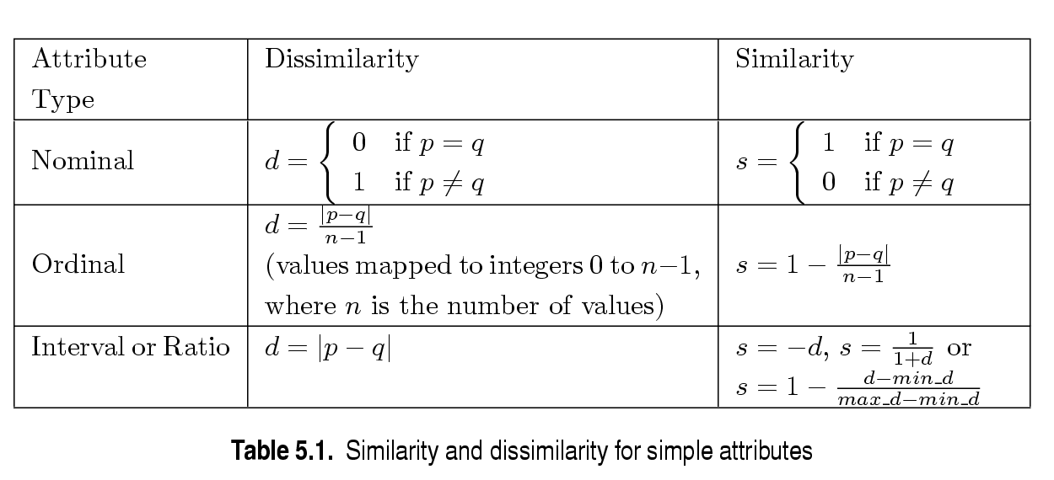
Similarity/Dissimilarity for Simple Attributes
p and q are the attribute values for two data objects.

Slide 38
Euclidean Distance
Euclidean Distance
  Where n is the number of dimensions (attributes) and p_{k} and q_{k} are, respectively, the k^{th} attributes (components) or data objects p and q.
Standardization is necessary, if scales differ.

Slide 39
Euclidean Distance
Distance Matrix

Slide 40
Minkowski Distance
Minkowski Distance is a generalization of Euclidean Distance
  Where r is a parameter, n is the number of dimensions (attributes) and p_{k} and q_{k} are, respectively, the kth attributes (components) or data objects p and q.

Slide 41
Minkowski Distance: Examples
r = 1. City block (Manhattan, taxicab, L₁ norm) distance.
  A common example of this is the Hamming distance, which is just the number of bits that are different between two binary vectors
r = 2. Euclidean distance
r → ∞. “supremum” (L_{max} norm, L∞ norm) distance.
  This is the maximum difference between any component of the vectors
Do not confuse r with n, i.e., all these distances are defined for all numbers of dimensions.

Slide 42
Minkowski Distance
Distance Matrix

Slide 43
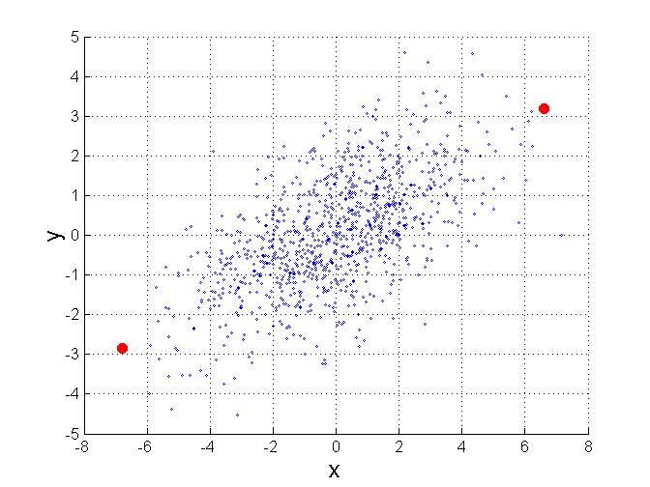
Mahalanobis Distance
Σ is the covariance matrix of the input data X
For red points, the Euclidean distance is 14.7, Mahalanobis distance is 6.

Slide 44
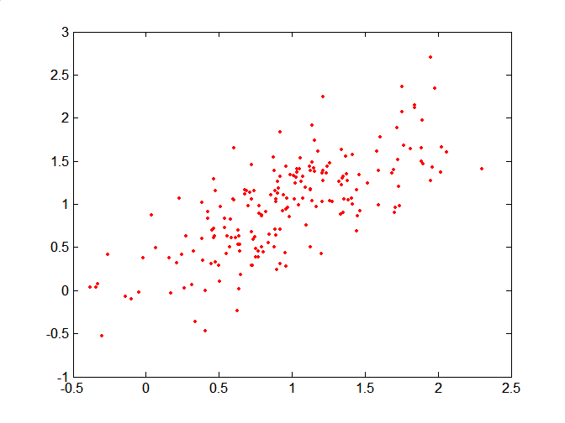
Mahalanobis Distance
Covariance Matrix:
C
B
A: (0.5, 0.5)
B: (0, 1)
C: (1.5, 1.5)
Mahal(A,B) = 5
Mahal(A,C) = 4
A

Slide 45
Common Properties of a Distance
Distances, such as the Euclidean distance, have some well known properties.
  d(p, q) ≥ 0 for all p and q and d(p, q) = 0 only if
  p = q. (Positive definiteness)
  d(p, q) = d(q, p) for all p and q. (Symmetry)
  d(p, r) ≤ d(p, q) + d(q, r) for all points p, q, and r.
  (Triangle Inequality)
where d(p, q) is the distance (dissimilarity) between points (data objects), p and q.
A distance that satisfies these properties is a metric

Slide 46
Common Properties of a Similarity
Similarities, also have some well known properties.
  s(p, q) = 1 (or maximum similarity) only if p = q.
  s(p, q) = s(q, p) for all p and q. (Symmetry)
where s(p, q) is the similarity between points (data objects), p and q.

Slide 47
Similarity Between Binary Vectors
Common situation is that objects, p and q, have only binary attributes
Compute similarities using the following quantities
M₀₁ = the number of attributes where p was 0 and q was 1
M₁₀ = the number of attributes where p was 1 and q was 0
M₀₀ = the number of attributes where p was 0 and q was 0
M₁₁ = the number of attributes where p was 1 and q was 1
Simple Matching and Jaccard Coefficients
SMC = number of matches / number of attributes
= (M₁₁ + M₀₀) / (M₀₁ + M₁₀ + M₁₁ + M₀₀)
J = number of 11 matches / number of not-both-zero attributes values
= (M₁₁) / (M₀₁ + M₁₀ + M₁₁)

Slide 48
SMC versus Jaccard: Example
p = 1 0 0 0 0 0 0 0 0 0
q = 0 0 0 0 0 0 1 0 0 1
M₀₁ = 2 (the number of attributes where p was 0 and q was 1)
M₁₀ = 1 (the number of attributes where p was 1 and q was 0)
M₀₀ = 7 (the number of attributes where p was 0 and q was 0)
M₁₁ = 0 (the number of attributes where p was 1 and q was 1)
SMC = (M₁₁ + M₀₀)/(M₀₁ + M₁₀ + M₁₁ + M₀₀) = (0+7) / (2+1+0+7) = 0.7
J = (M₁₁) / (M₀₁ + M₁₀ + M₁₁) = 0 / (2 + 1 + 0) = 0

Slide 49
Cosine Similarity
If d₁ and d₂ are two document vectors, then
cos( d₁, d₂ ) = (d₁ • d₂) / ||d₁|| ||d₂|| ,
where • indicates vector dot product and || d || is the length of vector d.
Example:
d₁ = 3 2 0 5 0 0 0 2 0 0
d₂ = 1 0 0 0 0 0 0 1 0 2
d₁ • d₂= 3*1 + 2*0 + 0*0 + 5*0 + 0*0 + 0*0 + 0*0 + 2*1 + 0*0 + 0*2 = 5
||d₁|| = (3*3+2*2+0*0+5*5+0*0+0*0+0*0+2*2+0*0+0*0)^{0.5} = (42) ^{0.5} = 6.481
||d₂|| = (1*1+0*0+0*0+0*0+0*0+0*0+0*0+1*1+0*0+2*2) ^{0.5} = (6) ^{0.5} = 2.245
cos( d₁, d₂ ) = .3150

Slide 50
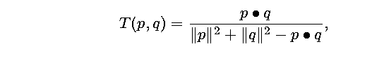
Extended Jaccard Coefficient (Tanimoto)
Variation of Jaccard for continuous or count attributes
  Reduces to Jaccard for binary attributes

Slide 51
Correlation
Correlation measures the linear relationship between objects
To compute correlation, we standardize data objects, p and q, and then take their dot product

Slide 52
Correlation analysis
Can detect redundancies

Slide 53
Cont’d
> 0 , A and B positively correlated
  values of A increase as values of B increase
  The higher the value, the more each attribute implies the other
  High value indicate that A (or B) may be removed as a redundancy
= 0, A and B independent (no correlation)
< 0, A and B negatively correlated
  Values of one attribute increase as the values of the other attribute decrease (discourages each other)

Slide 54
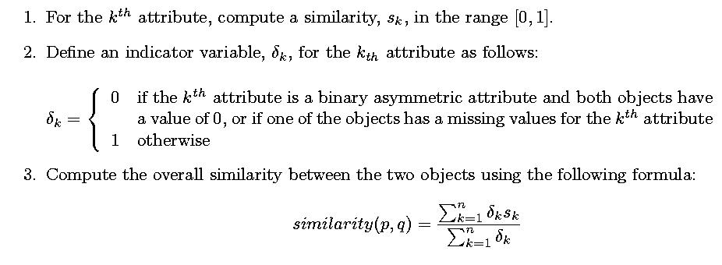
General Approach for Combining Similarities
Sometimes attributes are of many different types, but an overall similarity is needed.

